Slide 1

Reported by
K. Dhivya

Slide 2
Introduction
Heart Disease describes a range of conditions that affect the heart. Different types of heart diseases are diagnosed in people these days. Lets see the analysis of people having heart diseases based on different factors.
Heart disease by gender analysis
Gender
Heart disease due to other factors
Other factors
Age
Heart disease by age analysis
Heart disease by heart rates analysis
Heart Rates

Slide 3
Dataset Insights:
Numerical Features :(4)
Oldpeak
Slope
Ca
Thal
Target
Fbs
Restecg
Cp
Age
Thalach
Trestbps
Chol
Categorical features : (10)
Sex
Exang

Slide 4
Dimensions of the data set is 1025 rows and 14 features.
After removing the outliers from the dataset, the dataset consists of 523 records for people having heart disease and 495 records for people without heart disease.
Among those targets, 713 are of Sex type 1 and 312 are of Sex type 2.
No null values are found in the dataset.
The different categorical attributes:
  Chest Pain Type(Cp as 0,1,2,3)
  Fasting Blood Sugar(fbs as 0 and 1)
  restecg as 0,1,2
  Exercise induced angina(exang as 0 and 1)
  ST depression induced by exercise relative to rest
  the slope of the peak exercise ST segment(slope as 0,1,2 )
  Number of major vessels colored by flourosopy(ca 0,1,2,3,4)
  thal 0,1,2,3

Slide 5
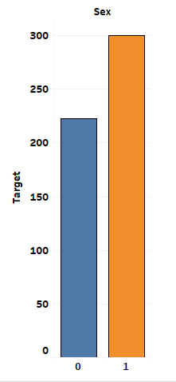
Gender:
The sex type 1(count: 300) is more prone to heart disease in comparison with type 0 (count:223).
The Sex type also plays a major role in certain other features where they are prone to heart disease.

Slide 6
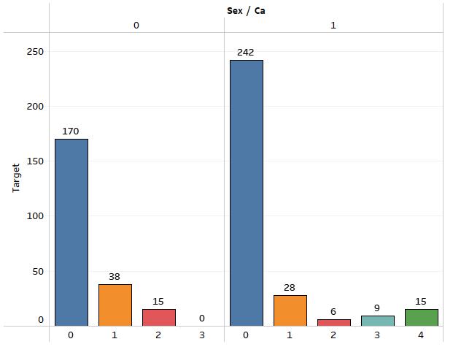
Ca Type:
NOTE: ca-number of major vessels colored by flourosopy
The Ca type 0 is more prone to heart disease in comparison with the other types on both sex types.
But on comparison, Sex type 1 is more prone to heart diseases rather than Sex type 0 from the analysis.
There is not even a note of Ca type 3 and 4 in Sex type 0.

Slide 7
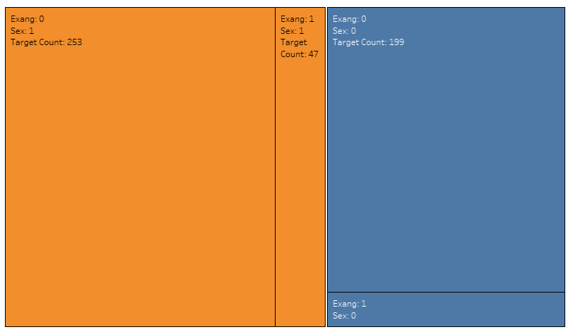
Exang Type:
The Exang type 0 is more prone to heart disease in comparison with the type 1 on both sex types.
But on comparison, Sex type 1 is more prone to heart diseases rather than Sex type 0 from the exang analysis.

Slide 8
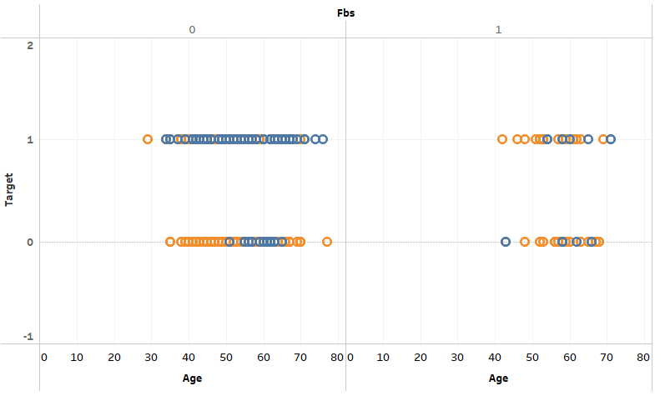
Fbs Type:
NOTE: Fbs type (1: > 120 mg/dl, 0: <=120 mg/dl)
The Fbs type 0 is more prone to heart disease in comparison with the type 1 on both sex types.
But on comparison, Sex type 1 is more prone to heart diseases rather than Sex type 0 from this fbs analysis.
Fbs type 0 is most probably found in age groups between 28 and 80, while Fbs type 1 was found between age groups 40 and 75.

Slide 9
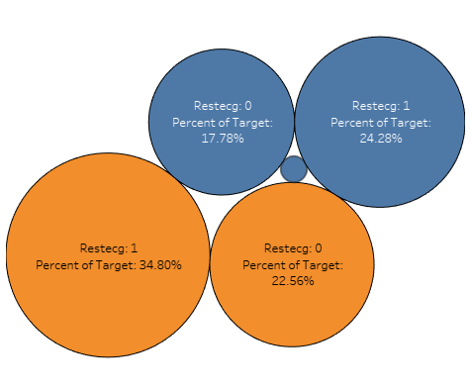
Restecg:
NOTE: Restecg: resting electrocardiographic results
The Restecg type 1 is more prone to heart disease in comparison with the type 1 on both sex types.
But on comparison, Sex type 1 is more prone to heart diseases rather than Sex type 0 from this restecg analysis.

Slide 10
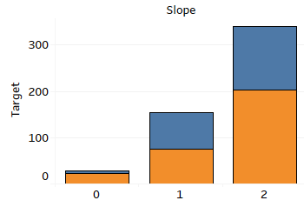
Slope:
NOTE: slope-the slope of the peak exercise ST segment
The slope type 2 is more prone to heart disease in comparison with the other types on both sex types.
The slope type 0 is seen in very few people.
But on comparison, Sex type 1 is more prone to heart diseases rather than Sex type 0 from the slope analysis.

Slide 11
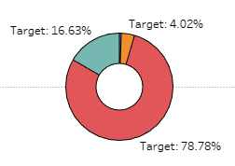
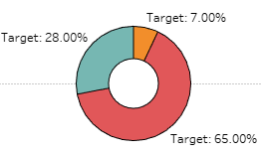
Thal:
Sex 0:
Sex 1
3
1
1
3
2
2
NOTE: thal: 0 = normal; 1 = fixed defect; 2 = reversable defect
The Thal type 2 is more prone to heart disease in comparison with its other types on both sex types.
There are very few traces of Thal type 0 found among people. Thal type 1 and 3 are found in moderate amounts.
No record of Thal type 0 is found in Sex type 1.
But on comparison, Sex type 1 is more prone to
heart diseases rather than Sex type 0 from the thal
analysis.

Slide 12
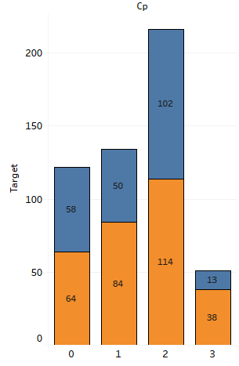
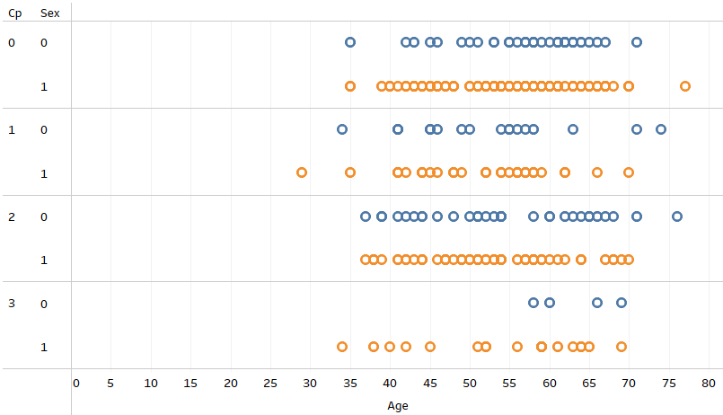
Cp Type:
NOTE: cp-Chest Pain type
The Cp type 2 is more prone to heart disease in comparison with its other types on both sexes.
On comparison, Sex type 1 is more prone to heart diseases rather than Sex type 0 from this Cp analysis.
These Cp types are most probably found between age
groups of 33 and 80, whereas Type 1 is can be even seen
at the age of 28 and above.
Cp type 3 is noticeably very few in Sex type 0 and was
also seen above the age group of 58 and above.

Slide 13

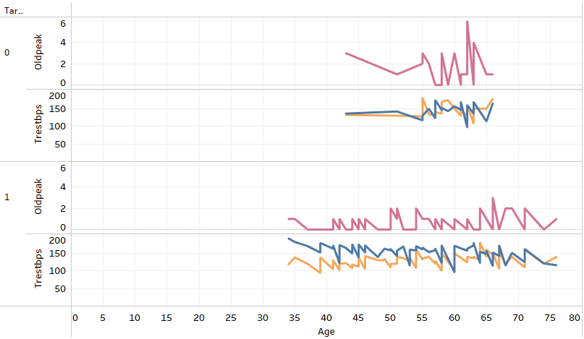

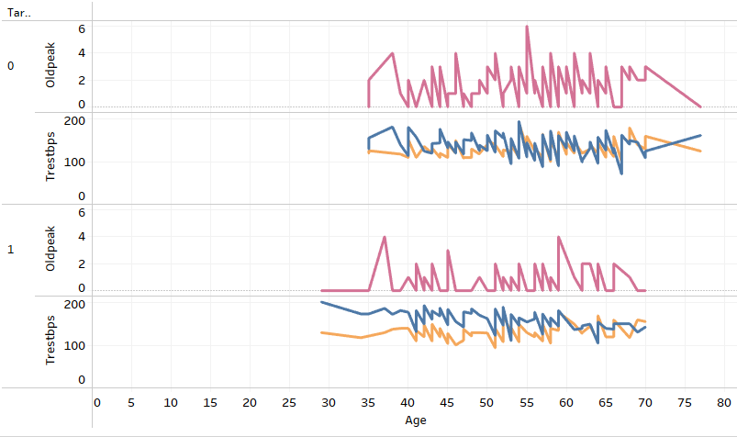

Trestbps,Old Peak,Thalach:

Slide 14
Old peak:
NOTE: Oldpeak - ST depression induced by exercise relative to rest
For Sex type 0 and Target 0 ,the Old peak falls between 0 and 3 for the age group between 43 and 62 , old peak also goes above 3 for age group above 62.
For Sex type 0 and Target 1,the Old peak was seen to be falling in 1 and 2 for age group between 34 and 64, also oldpeak was seen reaching atmost 3 for age group 65 and above.
Therefore patients with heart disease of Sex type 0 have chances to have the lower old peak than with the healthy ones as 1 to 3.
For Sex type 1 and Target 0 ,the Old peak falls between 0 and 4 for the age group between 35 and 54 , oldpeak also goes above 4 until 6 for age group 55 and above.
For Sex type 1 and Target 1,the Old peak was seen
to be falling in 4 and below ,for age group between
30 and 70.
Therefore patients with heart disease of Sex type 1
have chances to have lower old peak than with
the healthy ones as 0 to 4.

Slide 15
Trestbps:
NOTE: Trestbps- Resting Blood Pressure
For Sex type 0 and Target 0 ,the Trestbps falls between 80 and 180 for the age group between 43 and 66.
For Sex type 0 and Target 1,the Trestbps was seen to be falling between 80 and 180 for age group between 34 and 76.
For Sex type 1 and Target 0 ,the Trestbps falls between 100 and 200 for the age group between 35 and 77.
For Sex type 1 and Target 1,the Trestbps was seen to be falling between 90 and 180 for age group between 28 and 70.
Therefore patients with heart disease seem to have
Trestbps of range 80-180.

Slide 16
Thalach:
NOTE: Thalach – Max. heart rate achieved
For Sex type 0 and Target 0 ,the Thalach falls between 90 and 170 for the age group between 43 and 66.
For Sex type 0 and Target 1,the Thalach was seen to be falling between 90 and 190 for age group between 34 and 76.
For Sex type 1 and Target 0 ,the Thalach falls between 70 and 190 for the age group between 35 and 77.
For Sex type 1 and Target 1,the Trestbps was seen to be falling between
100 and above 200 for age group between 28 and 70.
Therefore patients with heart disease seem to have Thalach value
between 70 and even above 200.

Slide 17

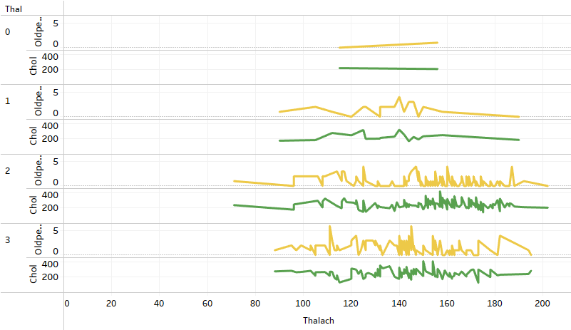
Chol,Thal,Old peak vs Thalach:
NOTE:
Thalach -Max. heart rate achieved
Chol -Serum cholestrol in mg/dl
Old Peak - ST depression induced by exercise relative to rest

Slide 18
For people without heart disease, Thal type 0,oldpeak 1, chol around 200mg/dl, the thalach value seem to be 156; For people with heart disease, thal type 0, oldpeak 0, chol around 200mg/dl, the thalach value is seem to be 115
For people without heart disease, Thal type 1,oldpeak less than 5, chol ranges (176-248)mg/dl, the thalach value ranges between (90 to 158); For people with heart disease, thal type 1, oldpeak less than 3, chol range (186 -201)mg/dl, the thalach value ranges between 126-190.
For people without heart disease, Thal type 2,oldpeak value less than 5, chol range (197-237)mg/dl, the thalach value ranges between (71-177). For people with heart disease, having thal type 2, oldpeak value less than 5, chol range between (178-204)mg/dl, the thalach value ranges between (96-202).
For people without heart disease, Thal type 3,oldpeak value 6 and less than 6 , with chol ranges (274-283)mg/dl, the thalach value ranges between (88-195); For people with heart disease, thal type 3, oldpeak less than 5, chol range (240-263)mg/dl, the thalach value ranges between (105-194).
Therefore increased chol value of average above 200mg/dl,
the thal values 1,2,3 and irrespective of slope value,
the heat rates are found to be above 100 for the person
with heart disease.

Slide 19
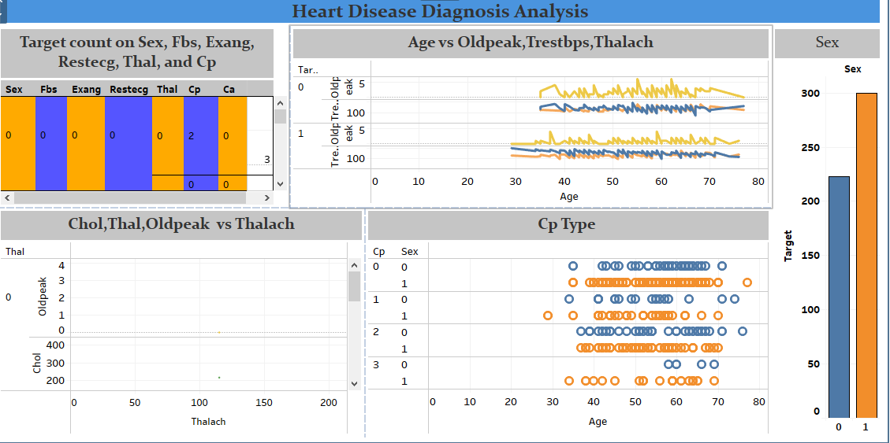
Mockup Dashboard:

Slide 20
Conclusion:
Both Sex types are prone to heart diseases in many cases. In comparison, Sex type 1 are more prone to heart disease.
Heart disease is found in all age groups above 25 according to this dataset. But we could conclude from the observation saying that ,age 50 and above are at greater risk since we have greater records with target positive in this category.
Increased heart rates (above 100) increases the chances of being prone to heart disease.
Increased chol value (above 180mg/dl) also increases the chance of being prone to heart disease.
As the slope value increases the heart rates increases, therefore it is also a factor increasing chances of heart disease.
The person having ca type 0 , exang type 0 , fbs type 0, restecg type 1,slope type 2,thal type 2,cp type 2,are at greater risk of heart diseases than the other of its types.

